Slide 1
Java on Matlab
Aug 29th, 2018
Yu-Wei Chen
yuweiichen@gmail.com

Slide 2
Outline
Pre-requires
Matlab Environment setting
JavaRobot API Explanation

Slide 3
Pre-requires
Download Eclipse IDE for Java https://www.eclipse.org/downloads/packages/
Clone the project on Github https://github.com/yuweichen1008/JavaRobot
Download the JDK at least version 8_u121 or any version newer http://www.oracle.com/technetwork/java/javase/downloads/jdk8-downloads-2133151.html
(Optional) Install the Matlab (you can find the install on NCTU FTP, but this is optional)

Slide 4
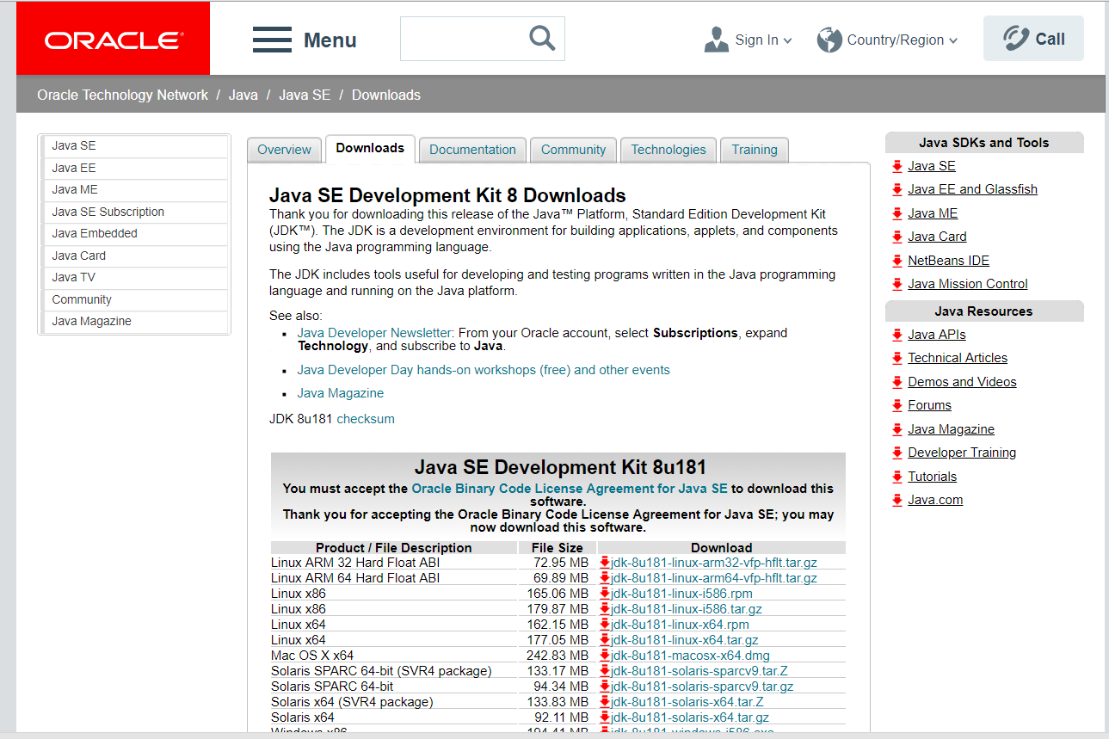
Java JDK download
http://www.oracle.com/technetwork/java/javase/downloads/jdk8-downloads-2133151.html

Slide 5
Matlab Environment Setup
For the Windows 8, 10 environment, JavaRobot used and tested

Slide 6
Matlab Environment setting
In Matlab, Java version is depended on the install environment. To make sure the version of Java is concessive to the version of JavaRobot , type
In the Command Windows
version –java
*Note that if your Java version is not the latest version, please use the uninstall tool here
https://java.com/en/download/uninstalltool.jsp
If the version you are using is not Java Runtime Environment 1.8.0_121 (aka 1.8.0_121-b13), then you may download it from the website or the link here:
http://www.oracle.com/technetwork/java/javase/downloads/jre8-downloads-2133155.html
Current computer is based on x64 structure, make sure you’ve downloaded the right files

Slide 7
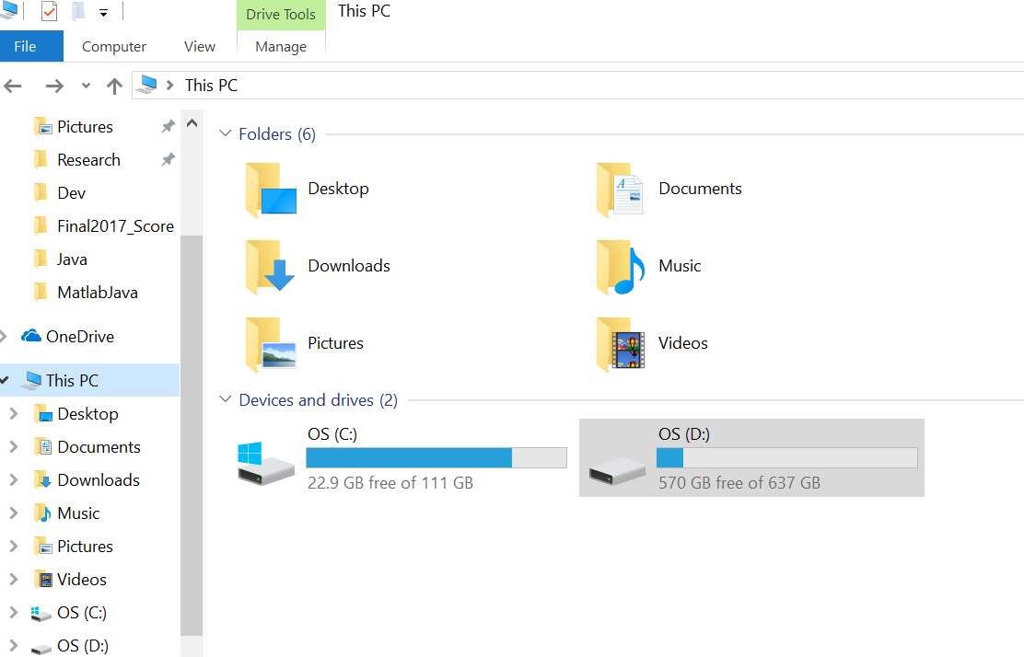
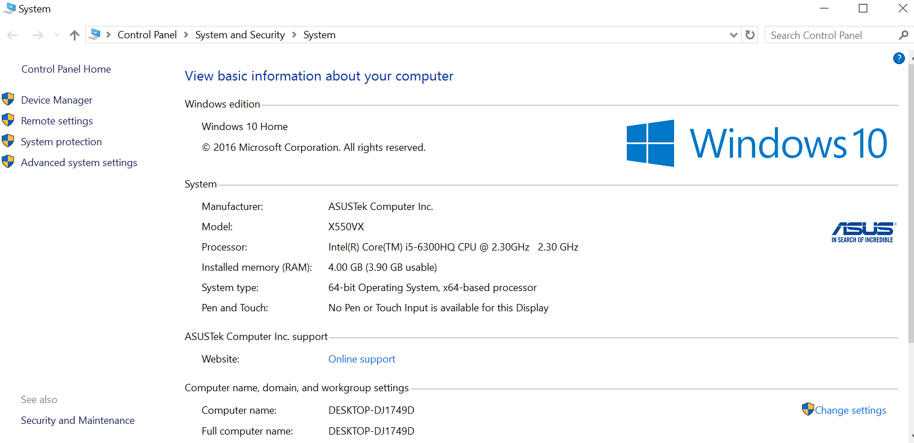
Under Windows Operation System
Step 1 : right click This PC → properties
Step 2 : go to Advanced system settings

Slide 8
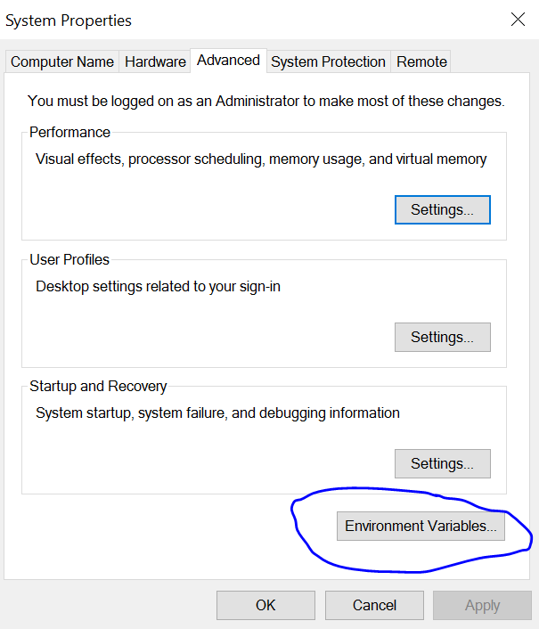
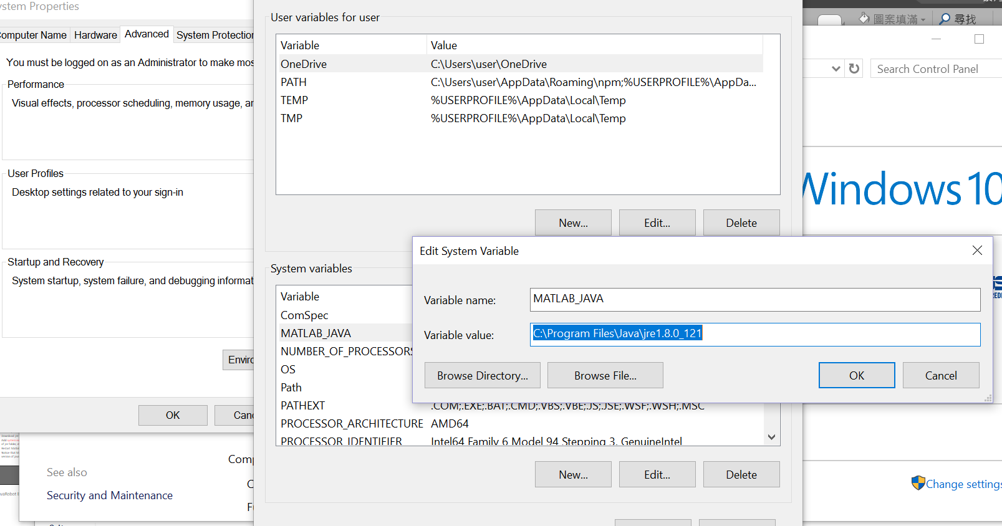
Under Windows OS
Go into the Environment variables
And create a system variable named MATLAB_JAVA with path variable
value of the jre file you’ve install

Slide 9
Matlab Environment setting
If you still got some problem setting up the environment on other OS, the step is quite the same:
Check up Matlab Java version →
Download jre corresponding to the jre file we are using currently →
Add system environment variable called MATLAB_JAVA and its value of jre folder, etc. C:\Program Files\Java\jre 1.8.0_121
Restart Matlab and check version –java again
Notice that Matlab call method may be dysfunctional for other version of java file.

Slide 10
JavaRobot Explanation
[JavaRobot, Tool, RefPosRMatrix] = JavaRobotRead();
JavaRobot is an object representing the Robot, which be used in every function below.
Tool store the original position data
RefPosRMatrix → Reference Position Rotational Matrix
mThread = JavaRobotMove(Roll, Pitch, Yaw, JavaRobot, Tool, RefPosRMatrix)
mThread means the thread which will make sure the Robot’s moved to the target position
flag = mThread. isRobotMoveFinished()
flag of Boolean 0 -> false(Not yet)/ 1 -> true(Done!)

